Slide 1
Using ScriptHost to Schedule SQLPathFinder Queries
(view in slide show mode)

Slide 2
This presentation discusses how you can improve your productivity by scheduling SQLPathFinder queries to run on ScriptHost. This reduces manual interaction for frequently run queries and also prevents long-running jobs from tying up your personal computer

Slide 3
Agenda
Introduction
ScriptHost Job Cycle
How to Schedule
Tips

Slide 4

Introduction to Scheduling Queries
SQLPathFinder lets you schedule jobs using ScriptHost (SH)
E.g., you may schedule a query to run every day at 5:00 am that emails results to a distribution list
SH jobs run on servers spread throughout Intel, and run even if your PC is not connected to the network
There is a Fab, NSG & Assembly/Test (A/T) SH farm
To use SH you must have EAM permissions:
  For A/T, navigate to: Manufacturing -> ATM/FSM Eng Apps and MAO (MARS/ARIES/OASYS) -> ScriptHost -> ScriptHost ATM: Scripthost-ProdAT
  For FAB, navigate to: Manufacturing -> ATM/FSM Eng Apps and MAO (MARS/ARIES/OASYS) -> ScriptHost -> ScriptHost Adhoc: Goat (Scripthost-Intg) & Sheep (Scripthost-Prod)
  For NSG, navigate to: Manufacturing -> ATM/FSM Eng Apps and MAO (MARS/ARIES/OASYS) -> ScriptHost -> ScriptHost NSG (Scripthost-NSG)

Slide 5
ScriptHost Recommendations
Use for Mission Important work as Level 3 support is next business day
The maximum allowed job frequency is every 15 minutes
Spread job starts across the hour so all do not start on the hour
  E.g., start job at 7:05 am rather than 7:00 am if possible
Make the job type manual or delete jobs when no longer needed
Use a job queue size that is slightly longer than the job execution time.
  E.g., for a 30m job, set Job Queue to 1 hour
For file output, use one of the SH process-specific shares (\\@@SHFS\@@Analysis$\, where @@ is az, azat, or, ir, is, dl
  Place output underneath a process-specific sub-folder
  Data on share is retained for 90d. Place any scripts or config. files you need persisted in the Config sub-folder
Add queue attribute App=JMP for JMP jobs

Slide 6
A/T ScriptHost (SH) Farm Shares
Description | Path
NAS share to store SH output so A/T users with a MAO account can access. Data is retained for 90d, unless placed under the Config sub-folder | \\AZATSHFS.intel.com\AZATAnalysis$\ A/T data should be placed underneath sub-folder MAOATM and SPTD data underneath DETD_MAO Share \\atdfile3.ch.intel.com is also available for Read & Write
Personal Folder. Only you can read /write. | \\SHUser-ProdAT.intel.com\SHProdATUser$\<username>\
Temp Space Folder. Only you can read/write. Files older than 14d are purged | \\azATSHFS.intel.com\azATSHTemp$\<username>
A/T SH web server for users to view SH web results | http://azatshweb.intel.com/azatAnalysis$/ Faster to view results via web server than via file share

Slide 7
Fab ScriptHost (SH) Farm Shares
Description | Path
NAS share to store SH output users with a MAO account can access. Data is retained for 90d, unless placed under the Config sub-folder | \\@@SHFS.intel.com\@@Analysis$\ …where @@ is one of az, or, ir, is, dl Process specific data should be placed underneath the appropriate process-specific sub-folder. E.g., 1272 data should be placed underneath folder 1272_MAOData
Personal Folder. Only you can read /write | \\SHUser-Prod.intel.com\SHProdUser$\<username>\
Temp Space Folder. Only you can read/write. Data older than 14d is purged | \\@@SHFS.intel.com\@@SHTemp$\<username>
Fab SH web server for users to view SH results | http://azshweb.intel.com/azAnalysis$/ Faster to view results via web server than via file share

Slide 8
Agenda
Introduction
ScriptHost Job Cycle
How to Schedule
Tips

Slide 9
ScriptHost (SH) Job Cycle
1
Script Host
(SH)
Personal
Folder
Save Executable
Your PC
To use SH, first save the query as a packed executable onto your SH personal share.
SPF Work
Folder

Slide 10
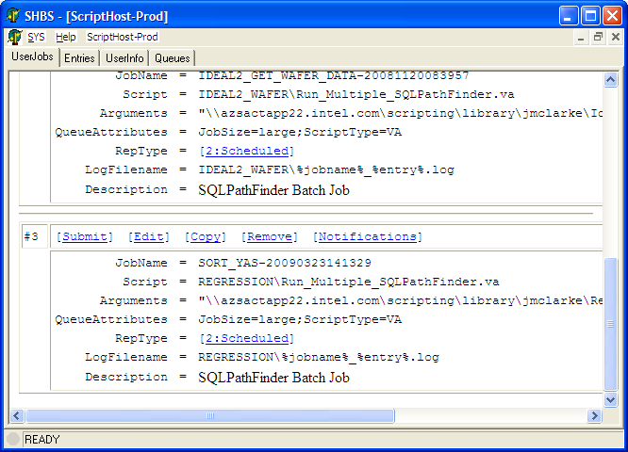
ScriptHost (SH) Job Cycle
Script Host
(SH)
Personal
Folder
2
Initiate job. Copy
Executable only to
available Drone
Script Host
Dispatcher
Drone
Server
When the job runs on SH, SH first copies the executable onto an available drone server so it can be run. No other files are copied. The SPF work folder is on the drone
SPF Work
Folder

Slide 11
ScriptHost (SH) Job Cycle
Script Host
(SH)
Folders
The query extracts & processes data from databases. Any additional files needed by job must be copied into the work folder on drone before use. Output files should be copied from drone to the SH Analysis share
3
Drone
Server
Copy or
reference
additional
files
MARS
ARIES
OASys
Other
3
Run query
SPF Work
Folder

Slide 12
ScriptHost (SH) Job Cycle
Script Host
(SH)
Personal &
Analysis folders
Your PC
4
Drone
Server
When job completes, SH copies job log back to your personal SH folder and, depending on how job was configured, may also copy residual files to your SH personal folder.
SPF Work
Folder

Slide 13
ScriptHost (SH) Job Cycle
Script Host
(SH)
Personal &
Analysis folders
5
Your PC
You may access job results by referencing the appropriate SH share or the SH Analysis web server
SPF Work
Folder

Slide 14
Agenda
Introduction
ScriptHost Job Cycle
How to Schedule
Tips

Slide 15
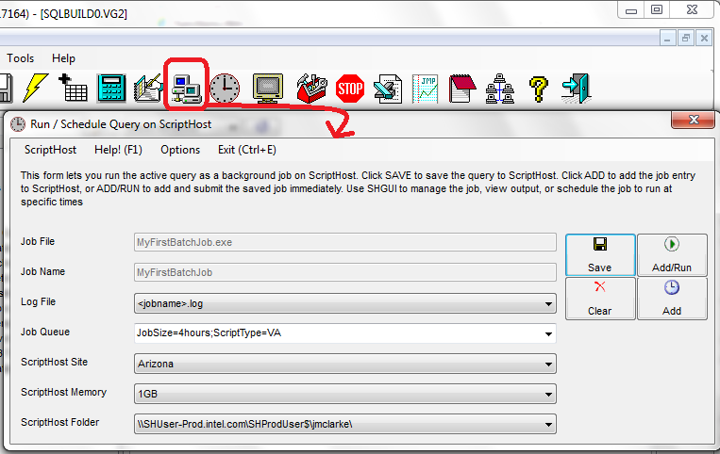
How to Schedule
Load your query, and select icon Run Job in Batch On ScriptHost to invoke form Run / Schedule Query on ScriptHost
1

Slide 16
How to Schedule
Set an appropriate job queue, the drone site where you would like your Query to run and an optional memory size for the job.
2

Slide 17
How to Schedule
Choose the Fab or A/T ScriptHost folder
  Fab: \\SHUser-Prod.intel.com\SHProdUser$\<username>\
  A/T: \\SHUser-ProdAT.intel.com\SHProdATUser$\<username>\
3

Slide 18
How to Schedule
Click the Save button to save the job to ScriptHost
4

Slide 19
How to Schedule
Click either the:
  Add button to add a job entry to ScriptHost, or the
  Add/Run button to add a job entry to ScriptHost and also to run the job immediately
5

Slide 20
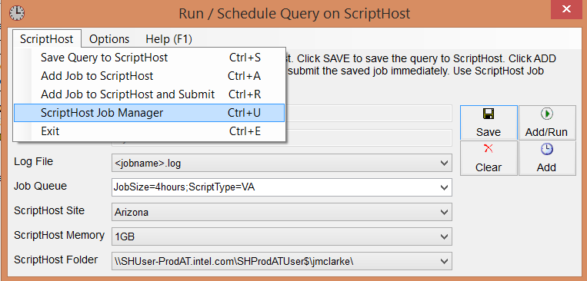
How to Schedule
To enter a schedule, start the ScriptHost Job manager.
Select menu:
    ScriptHost -> ScriptHost Job Manager
6

Slide 21
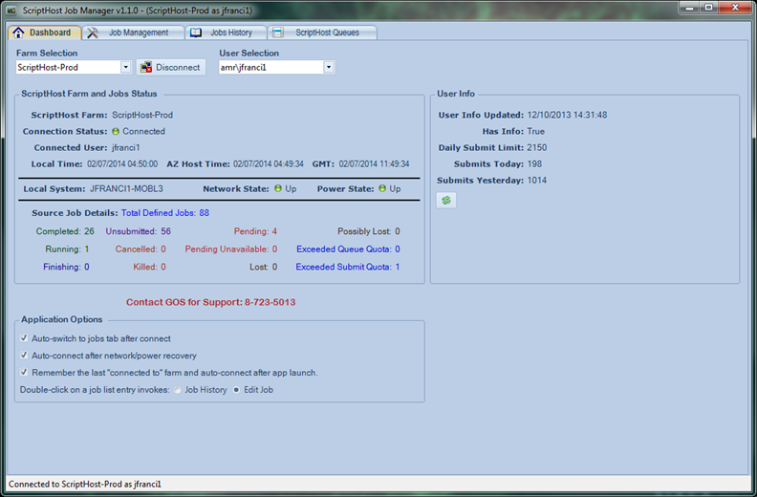
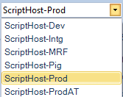
How to Schedule
The SH Dashboard lets you see your SH Job Summary
The ScriptHost Job Manager is invoked. You must first make sure you are connected to the desired ScriptHost Farm
It also lets you see your job Daily Quota

Slide 22
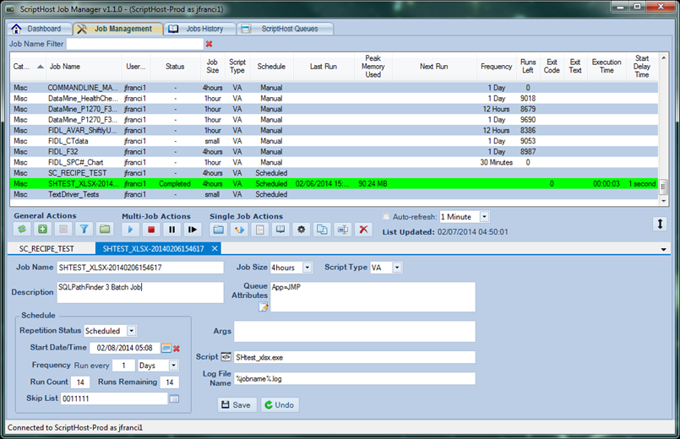
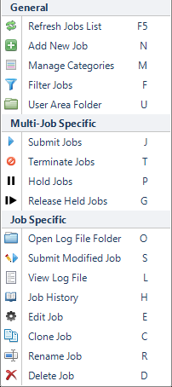
How to Schedule
The Job Management tab lets you interact with your jobs
Job List
Useful Job Information
Double Click on Job to see Details
Right Click on Job to see Options
SH Job Details

Slide 23

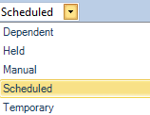
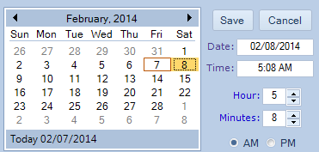
How to Schedule – Job Details
Set the Job Repetition Status to Scheduled
Click on the Calendar icon to set the job start date and time
Set the number of times to run job
Set the Job Skip List (a series of 0s and 1s that determine what instances should be skipped.) Can click icon for help
Notes:
Skip List is a:
String of 0's & 1's noting intervals a job should skip.
Only needed if some intervals should be skipped. If empty, job submitted at every interval.
ScriptHost uses one digit for each interval and when it hits the end of the pattern, it repeats from the beginning
First digit represents the Start Date Time.
For daily patterns, need to know what day of week you are starting on
In e.g., a daily interval is specified starting on Sunday & Saturday will be skipped.
1111110 => Su, Mo, ..., Sa

Slide 24
ScriptHost (SH) Skip List
The Skip List is a:
  String of 0's & 1's noting intervals a job should skip
  If empty, the job is submitted at every interval.
  SH uses one digit for each interval and when it hits the end of the pattern, it repeats from the beginning
  First digit represents the initial Start Date Time.
  If the initial start date is Wed, and you wish to run the job every work day and skip weekends, specify a skip list of 1110011.
      1 1 1 0 0 1 1
      We Th Fr Sa Su Mo Tu
  If the initial start date is a Sunday, and you wish to run the job every work day and skip weekends, you can specify a skip list of 0111110
      0 1 1 1 1 1 0
      Su Mo Tu We Th Fr Sa

Slide 25
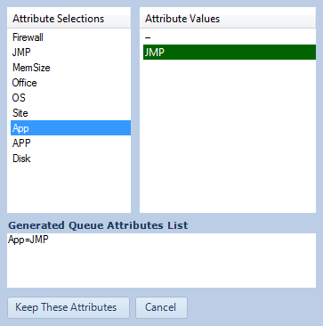
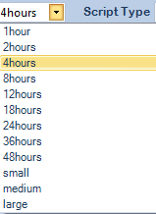
How to Schedule – Job Details
Set the Job Queue size
Click on Queue Attributes to assign items such as JMP queues or Memory allocation
Notes:
Skip List is a:
String of 0's & 1's noting intervals a job should skip.
Only needed if some intervals should be skipped. If empty, job submitted at every interval.
ScriptHost uses one digit for each interval and when it hits the end of the pattern, it repeats from the beginning
First digit represents the Start Date Time.
For daily patterns, need to know what day of week you are starting on
In e.g., a daily interval is specified starting on Sunday & Saturday will be skipped.
1111110 => Su, Mo, ..., Sa

Slide 26
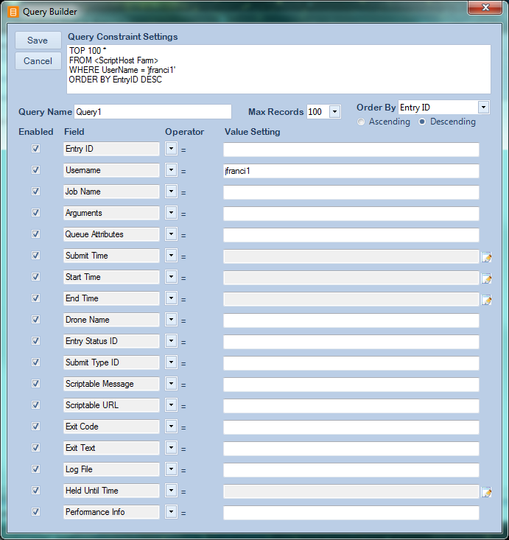
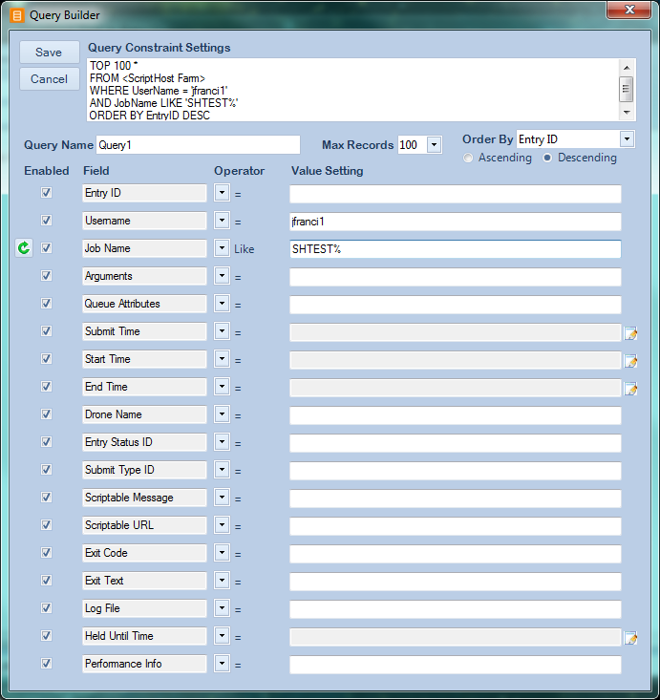
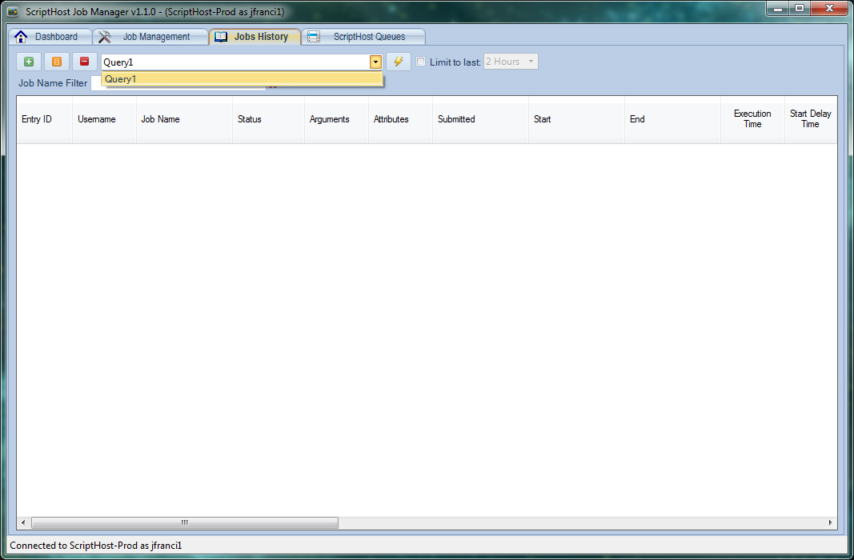
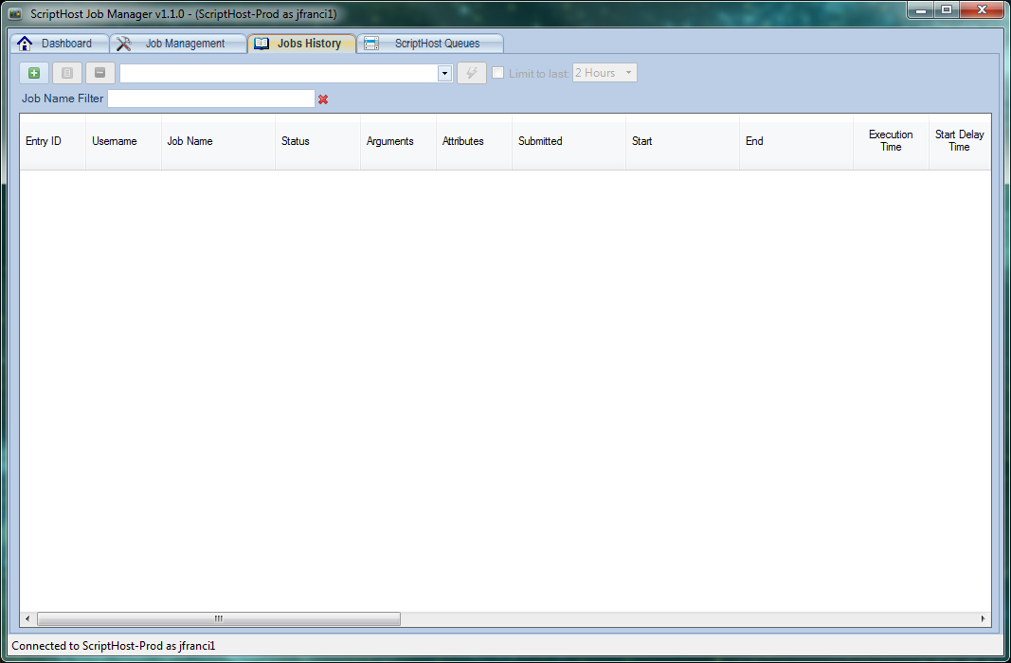
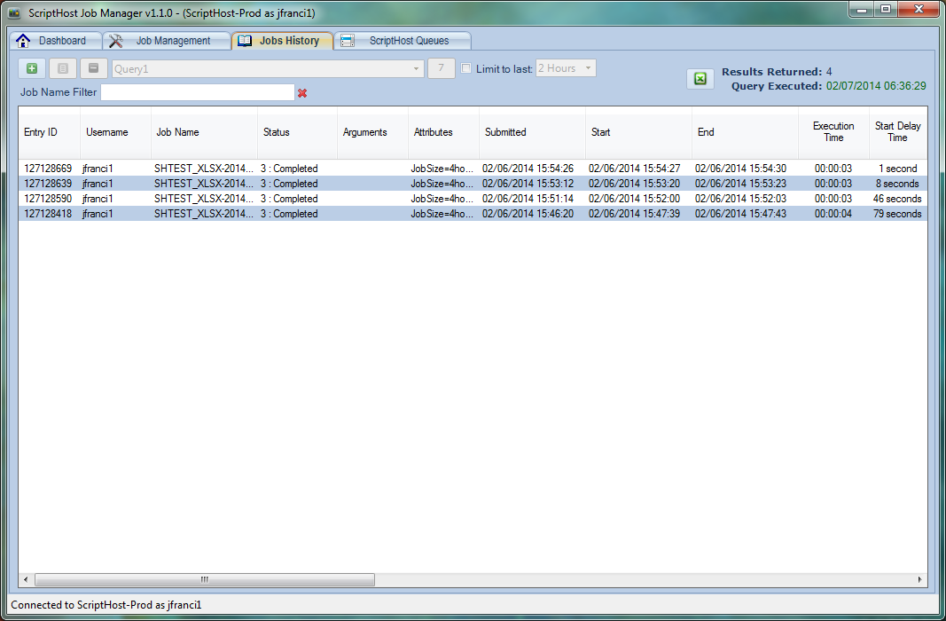
How to Schedule – Job History
Click Save to save the job query
Execute Query
On the Job History tab, you can create job search queries. Click here to Add a New Query
Select Query From Dropdown

Slide 27
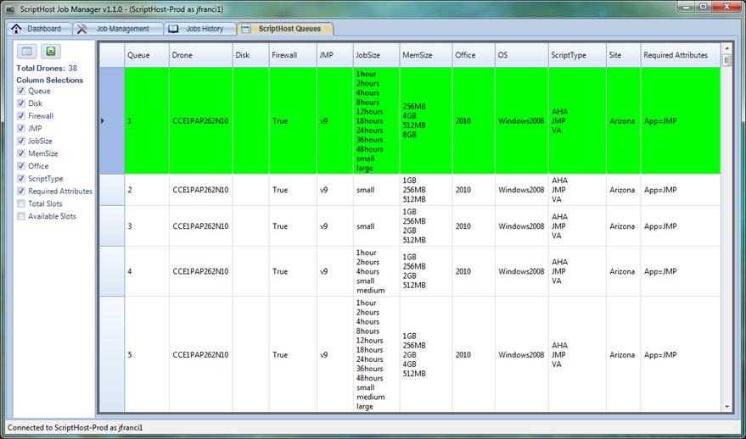
How to Schedule – ScriptHost Queues
The ScriptHost Queues tab lets you see what Job Queues are available

Slide 28
Agenda
Introduction
ScriptHost Job Cycle
How to Schedule
Tips

Slide 29
Tips - Viewing Logs while Job is in Process
  ScriptHost can also be accessed via a Terminal server.
  Connect (using Remote Desktop Connection) to:
    cceprd403.cdcprod.mfg.intel.com
Performs better for users not in Az or when over VPN
Lets you view ScriptHost job logs while jobs are in process

Slide 30
Final Quiz!
Following are a few questions on the use of ScriptHost. You are allowed several chances to answer a question correctly. So relax and have fun! ☺

Slide 31
Quiz
Question 1 – Multiple Choice
If you wish to schedule your ScriptHost query to run on Monday, Wednesday, and Friday only, and the start date of the first run is a Friday, what skip list should you specify?.
01010100
1010100
1001010
1111111
Notes:
31

Slide 32
Quiz
Question 2 – Multiple Choice
If your Skip list is 0010100, and the start date of the first run is a Sunday, what days of the week will the job run on?
Mon and Wed
Tue and Thu
Wed and Fri
Sat and Sun
Notes:
32

Slide 33
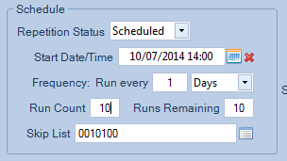
Quiz
Question 2 – Multiple Choice
If 10/7/2014 is a Monday, what does the attached image of a schedule do? It runs the job on …
Wed & Fri at 2pm for 2 weeks
Tue & Thu at 2pm for 5 weeks
Wed & Fri at 2pm for 5 weeks
Tue & Thu at 2pm for 2 weeks
Notes:
33

Slide 34
That concludes the presentation
on ScriptHost

